Slide 1

A Review of Research on Cloud Computing Economics
电子商务与智能服务研究中心
邓国华
2015.6.18

Slide 2
Contents
1
An Introduction of Cloud computing
2
Pricing schemes for Cloud computing
3
Market and Trade mechanism for Cloud computing
4
Microeconomic analysis for Cloud computing
5
Macroeconomic impact of Cloud computing
6
References

Slide 3
1 An Introduction of Cloud computing
1.1
Definitions of Cloud computing
1.2
Five essential characteristics
1.3
Three service models
3
1.4
Four deployment models
4
Notes:
[1]Staten J, Yates S, Gillett F E, et al. Is cloud computing ready for the enterprise[J]. Forrester Research, March, 2008, 7.
[2]Mell P, Grance T. The NIST definition of cloud computing[J]. National Institute of Standards and Technology, 2009, 53(6): 50.
[3]Youseff L, Butrico M, Da Silva D. Toward a unified ontology of cloud computing[C]//Grid Computing Environments Workshop, 2008. GCE'08. IEEE, 2008: 1-10.
[4]Cases C C U. A white paper produced by the Cloud Computing Use Case Discussion Group[J]. 2010.

Slide 4
1.1 Definitions of Cloud computing
An emerging IT development, deployment and delivery model, enabling real-time delivery of products, services and solutions over the Internet
IDC
A standardized IT capability (services, software, or infrastructure) delivered via Internet technologies in a pay-per-use, self-service way[1]
Forrester
cloud computing is a model for enabling convenient, on-demand network access to a shared pool of configurable computing resources that can be rapidly provisioned and released with minimal management effort or service provider interaction[2]
NIST

Slide 5
1.2 Five essential characteristics[2]
Broad network access
Resource pooling
Rapid elasticity
On-demand self-service
Measured service

Slide 6
1.3 Three service models[2][3]
Software as a Service (SaaS)
Applications running on a cloud infrastructure, accessible from a web browser or other thin client
Platform as a Service (PaaS)
Consumer-created applications deployed to the cloud infrastructure
Infrastructure as a Service (IaaS)
Processing or Computing, storage, networks, and other fundamental computing resources
SaaS
SalesForce-CRM, Google docs
PaaS
Google App Engine, Azure
IaaS
Amazon EC2/S3, Rackspace,GAC,Ali

Slide 7
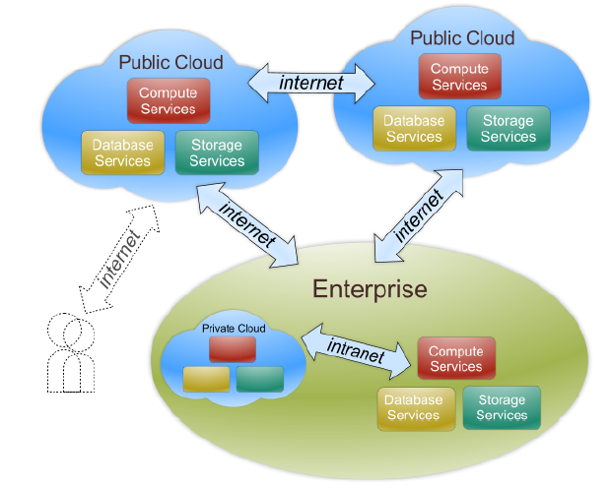
1.4 Four deployment models[2][4]
Hybrid cloud: composed of two or more clouds that remain unique entities but are bound together by standardized or proprietary technology that enables data and application portability
Public cloud: made available to the general public
Private cloud: operated for a single organization. It may be managed by the organization or a third party and may exist on premise or off premise.
Community cloud: shared by several organizations. It may be managed by the organizations or a third party and may exist on premise or off premise.

Slide 8
2 Pricing schemes for Cloud computing
A flat fee , a pay-per-use fee or a two-tier mixed[5]
Tiered pricing, Per-unit pricing and subscription pricing [3]
Game Theoretic Pricing Strategy[6][7][8]
Auction or Double-sided Auction Pricing[9][10]
Black-Scholes-Merton Model and Moore’s Law or Option pricing model[11][12]
Hotelling model Pricing[13]
Notes:
[5]Marston S, Li Z, Bandyopadhyay S, et al. Cloud computing—The business perspective[J]. Decision Support Systems, 2011, 51(1): 176-189.
[3]Youseff L, Butrico M, Da Silva D. Toward a unified ontology of cloud computing[C]//Grid Computing Environments Workshop, 2008. GCE'08. IEEE, 2008: 1-10.
[6]Urgaonkar B, Kesidis G, Shanbhag U V, et al. Pricing of service in clouds: optimal response and strategic interactions[J]. ACM SIGMETRICS Performance Evaluation Review, 2013, 41(3): 28-30.
[7]Pal R, Hui P. Economic models for cloud service markets: Pricing and capacity planning[J]. Theoretical Computer Science, 2013, 496: 113-124.
[8]Künsemöller J, Karl H. A game-theoretic approach to the financial benefits of infrastructure-as-a-service[J]. Future Generation Computer Systems, 2014, 41: 44-52.
[9] Mihailescu M, Teo Y M. Dynamic resource pricing on federated clouds[C]//Cluster, Cloud and Grid Computing (CCGrid), 2010 10th IEEE/ACM International Conference on. IEEE, 2010: 513-517.
[10] Shang S, Jiang J, Wu Y, et al. DABGPM: A double auction Bayesian game-based pricing model in cloud market[M]//Network and Parallel Computing. Springer Berlin Heidelberg, 2010: 155-164.
[11] Sharma B, Thulasiram R K, Thulasiraman P, et al. Pricing cloud compute commodities: a novel financial economic model[C]//Proceedings of the 2012 12th IEEE/ACM International Symposium on Cluster, Cloud and Grid Computing (ccgrid 2012). IEEE Computer Society, 2012: 451-457.
注：布莱克-舒尔斯期权定价模型（Black-Scholes Model），简称BS模型，是一种为期权或权证等金融衍生工具定价的数学模型
[12] Wang D, Wang Y, Liu J, et al. Pricing reserved and On-Demand Schemes of cloud computing based on option pricing model[C]//Network Operations and Management Symposium (APNOMS), 2013 15th Asia-Pacific. IEEE, 2013: 1-3.
[13] Keskin T, Taskin N. A pricing model for cloud computing service[C]//System Sciences (HICSS), 2014 47th Hawaii International Conference on. IEEE, 2014: 699-707.

Slide 9
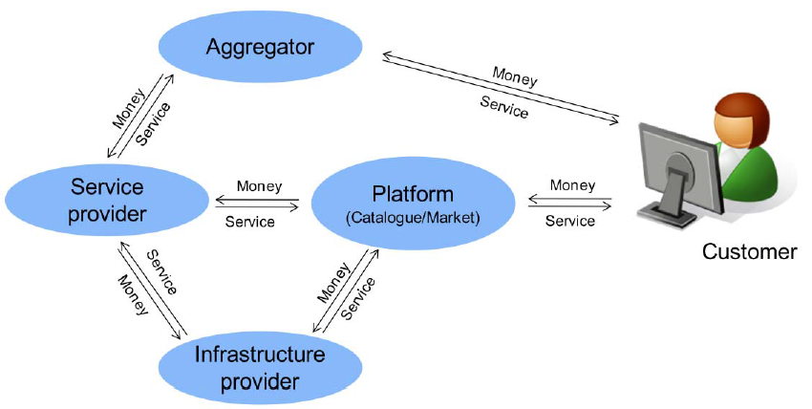
3 Market and Trade mechanism for Cloud computing
Value Chain of cloud computing[14]
Notes:
[14]Böhm M, Leimeister S, Riedl C, et al. Cloud computing–outsourcing 2.0 or a new business model for IT provisioning?[M]//Application management. Gabler, 2011: 31-56.
[15]Buyya R, Yeo C S, Venugopal S, et al. Cloud computing and emerging IT platforms: Vision, hype, and reality for delivering computing as the 5th utility[J]. Future Generation computer systems, 2009, 25(6): 599-616.
[16]陈冬林, 马明明, 吕秋云. 云服务组合交易模型研究[J]. 武汉理工大学学报: 信息与管理工程版, 2011, 33(3): 456-459.

Slide 10
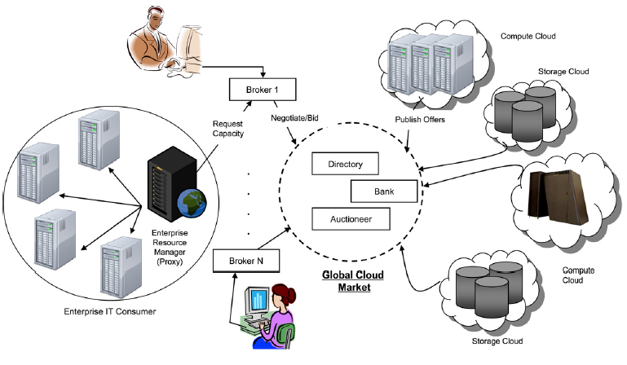
Global Cloud exchange and market infrastructure for trading services[15]

Slide 11
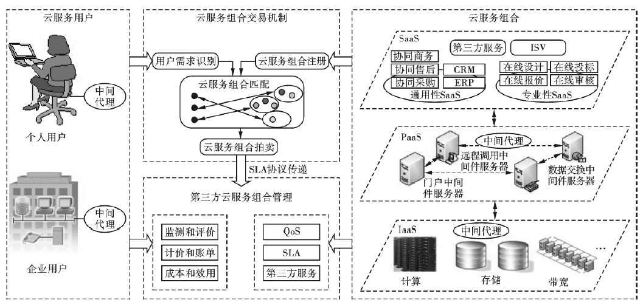
Cloud Service Collaboration Market Transaction Model[16]

Slide 12
4 Microeconomic analysis for Cloud computing
4.1
Economic costs- The enterprise perspective
4.2
Economies of scale
4.3
Elasticity
3
4.4
Demand and supply Analysis
4

Slide 13
4.1 Economic costs- The enterprise perspective
Cost-saving of Cloud computing
Economic costs Comparison(Traditional IT VS Cloud)
Cost-benefit analysis
Notes:
[17]Buyya R, Vecchiola C, Selvi S T. Mastering Cloud Computing: Foundations and Applications Programming[M]. Newnes, 2013.
[18]Talukder A K, Zimmerman L. Cloud economics: Principles, costs, and benefits[M]//Cloud computing. Springer London, 2010: 343-360.
[19] De Alfonso, Carlos, et al. "An economic and energy-aware analysis of the viability of outsourcing cluster computing to a cloud." Future Generation Computer Systems 29.3 (2013): 704-712.
[20].Li, Xinhui, et al. "The method and tool of cost analysis for cloud computing."Cloud Computing, 2009. CLOUD'09. IEEE International Conference on. IEEE, 2009.
[21]Brumec S, Vrček N. Cost effectiveness of commercial computing clouds[J]. Information Systems, 2013, 38(4): 495-508.
[22]Nanath K, Pillai R. A Model for Cost-Benefit Analysis of Cloud Computing[J].Journal of International Technology and Information Management, 2013, 22(3): 6.
[23] Misra S C, Mondal A. Identification of a company’s suitability for the adoption of cloud computing and modelling its corresponding Return on Investment[J]. Mathematical and Computer Modelling, 2011, 53(3): 504-521.
[24]刘森. 企业云计算信息化的投资回报率分析[J]. 中国科技论坛, 2014 (6): 83-87.
[25]Skilton M, Director C. Building Return on Investment from Cloud Computing[J]. White Paper, The Open Group, 2010.

Slide 14
Cost-saving of Cloud computing[18][19[23][27]
“Pay as you go”, No upfront capital investment——Allow capital to be redirected to core business investment.[17][5]
Converting capital expenses to operating expenses(CapEx to OpEX)——Lower break-even points(reduce operational and business risks[31]
Eliminating the depreciation costs associated with IT capital assets
Eliminating electricity, cooling, buildings and floor space costs
Cutting the maintenance and administrative costs of IT resource
Reducing human resource costs

Slide 15
Economic costs Comparison
Traditional IT costs
1.Capital costs（infra and software，one-time，）
2.Maintenance and operation
3.Electricity
4.Cooling
5.Buildings and floor space
6.Labor costs
7. Depreciation costs
Cloud Computing costs
1.Usage costs on a Pay-per-use basis
2.Subscriptions costs
3.Transfer costs(large enterprises)
4.Integration and app reengineering costs(large enterprises)
5.Labor Costs

Slide 16
Cost-benefit analysis
Total Cost of Ownership (TCO)[20][21][22]
Return on Investment(ROI)[23][24][25]
Notes:
[17]Buyya R, Vecchiola C, Selvi S T. Mastering Cloud Computing: Foundations and Applications Programming[M]. Newnes, 2013.
[18]Talukder A K, Zimmerman L. Cloud economics: Principles, costs, and benefits[M]//Cloud computing. Springer London, 2010: 343-360.
[19] De Alfonso, Carlos, et al. "An economic and energy-aware analysis of the viability of outsourcing cluster computing to a cloud." Future Generation Computer Systems 29.3 (2013): 704-712.
[20].Li, Xinhui, et al. "The method and tool of cost analysis for cloud computing."Cloud Computing, 2009. CLOUD'09. IEEE International Conference on. IEEE, 2009.
[21]Brumec S, Vrček N. Cost effectiveness of commercial computing clouds[J]. Information Systems, 2013, 38(4): 495-508.
[22]Nanath K, Pillai R. A Model for Cost-Benefit Analysis of Cloud Computing[J].Journal of International Technology and Information Management, 2013, 22(3): 6.
[23] Misra S C, Mondal A. Identification of a company’s suitability for the adoption of cloud computing and modelling its corresponding Return on Investment[J]. Mathematical and Computer Modelling, 2011, 53(3): 504-521.
[24]刘森. 企业云计算信息化的投资回报率分析[J]. 中国科技论坛, 2014 (6): 83-87.
[25]Skilton M, Director C. Building Return on Investment from Cloud Computing[J]. White Paper, The Open Group, 2010.

Slide 17
4.2 Economies of scale[26][17]
Supply-side scale
Demand-side
scale
Multi-tenancy
efficiency
Notes:
[26]Harms R, Yamartino M. The economics of the cloud[J]. Microsoft whitepaper, Microsoft Corporation, 2010.

Slide 18
Supply-side scale
Large-scale data centers(DCS) lower costs per server
Cost of power
Labor costs
Buying power
Lower PUE-location with inexpensive electricity supply ,bulk purchase agreement,
Automating management tasks, higher management efficiency
30% discount on hardware purchase

Slide 19
Demand-side scale[39]
Randomness
Utilization improvement and smooth variability via demand-side aggregation and diversification
Time-of-day patterns
Industry –specific variability
Multi-resource variability
Uncertain growth patterns

Slide 20
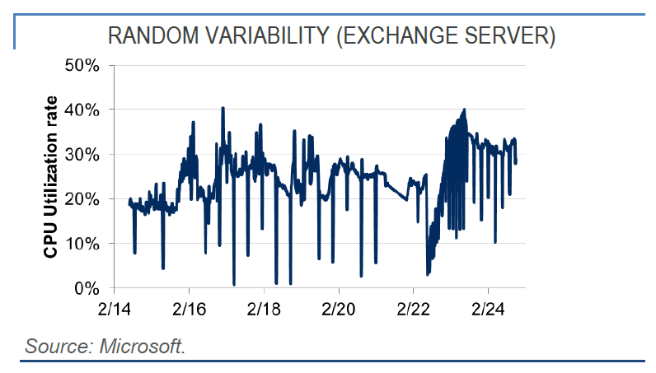
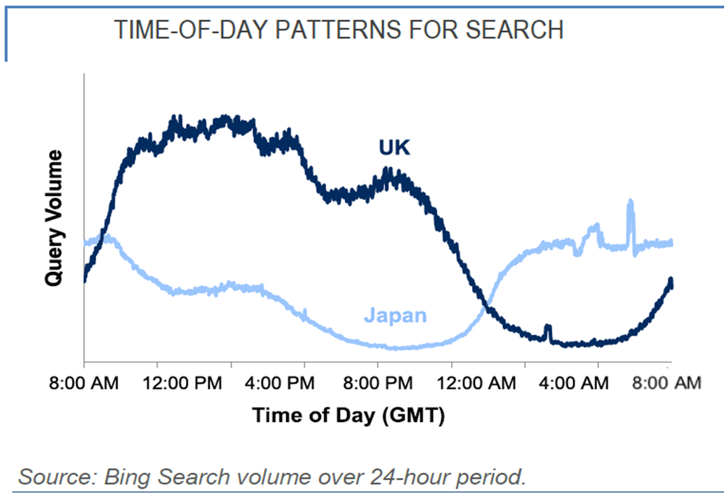
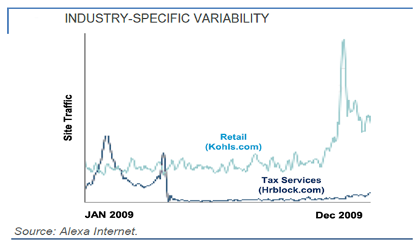
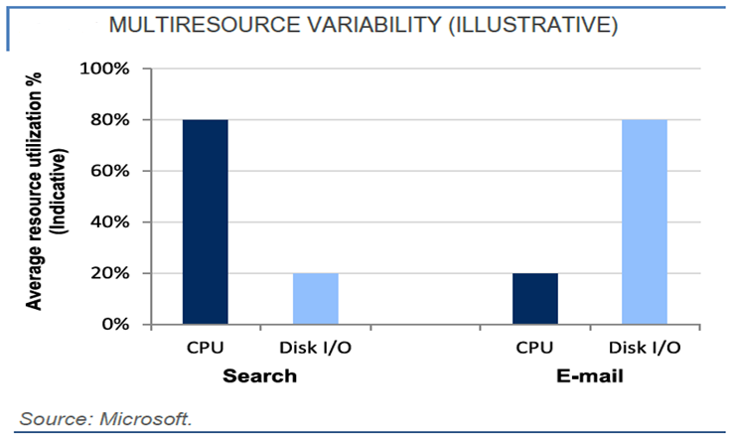
Demand-side scale

Slide 21
4.4 Demand and supply curve[30][31]
A reduction of ICT costs will shift the supply curve downwards and to the right. The shift will change the demand-supply equilibrium point and lower prices in the long-run.[Etro,2009]
The magnitude of the price changes are partially determined by the price elasticity of the demand curve.(Laverty J P et.al ,2014)
Cloud computing architectures may have a significant effect of reducing the marginal cost-per-unit(MC) of technology, which will affect resource and product pricing. In turn, cloud technologies may lower equilibrium prices for products and services to consumers, businesses and governments. (Laverty J P et.al ,2014)
Notes:
[30]Etro F. The economic impact of cloud computing on business creation, employment and output in Europe[J]. Review of Business and Economics, 2009, 54(2): 179-208.
[31]Laverty J P, Wood D F, Turchek J. MICRO AND MACRO ECONOMIC ANALYSIS OF CLOUD COMPUTING[J]. Issues in Information Systems, 2014, 15(2).

Slide 22
Multi-tenancy efficiency
Fixed application labor amortized over a large number of customers
Multiple customers use a single instance of the application simultaneously
Fixed component of server utilization amortized over a large number of customers

Slide 23
4.3 Elasticity[27][28][29]
Economic benefit of elasticity
Transference of risk
Overprovisioning –underutilization
Underprovisioning – saturation
Reduction of cost
Increase business flexibility and agility(Intangible economic benefit)
Elasticity strategies
Scaling out-in(Horizontal Scaling)
Scaling up-down(Vertical Scaling)
Hybrid Scaling
Economic analysis of elasticity
Cost of Elasticity(CoE)
Server scaling costs
Monitoring costs
Return on Elasticity(RoE)
Notes:
[27]Armbrust M, Fox A, Griffith R, et al. A view of cloud computing[J]. Communications of the ACM, 2010, 53(4): 50-58.
[28]Suleiman B, Sakr S, Jeffery R, et al. On understanding the economics and elasticity challenges of deploying business applications on public cloud infrastructure[J]. Journal of Internet Services and Applications, 2012, 3(2): 173-193.
[29] Erl T, Puttini R, Mahmood Z. Cloud Computing: Concepts, Technology, & Architecture[M]. Pearson Education, 2013.

Slide 24
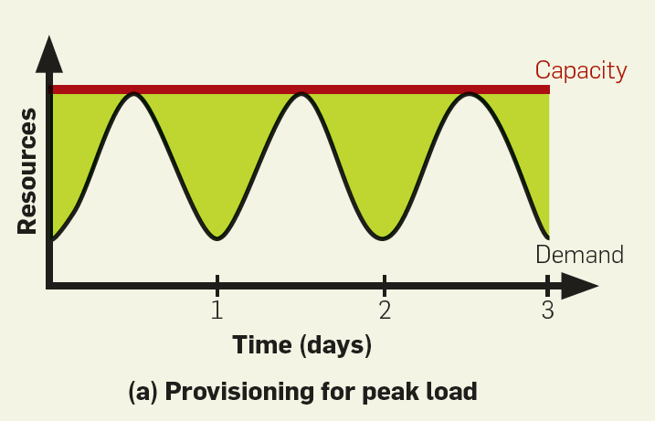
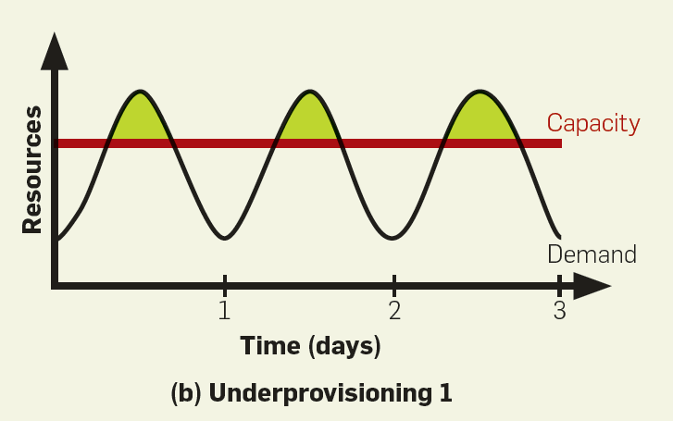
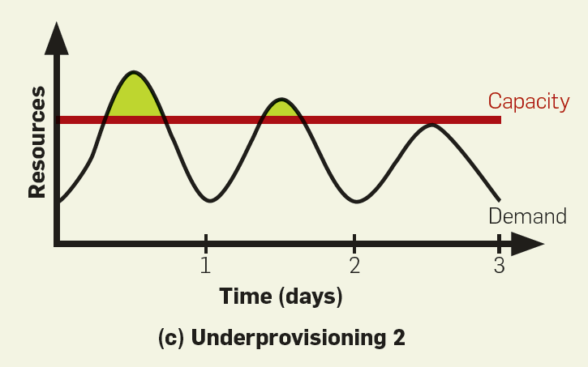
Resource deployment scenario[27]
Even if peak load can be correctly anticipated, without elasticity we waste resources (shaded area) during nonpeak times.
Underprovisioning case 1: potential revenue from users not served (shaded area) is sacrificed.
Underprovisioning case 2: some users desert the site permanently after experiencing poor service; this attrition and possible negative press result in a permanent loss of a portion of the revenue stream.
(a)
(b)
(c)

Slide 25
5 Macroeconomic impact of Cloud computing
5.1
Macroeconomic Effects of Cloud computing
3
The mechanism of cloud computing on macroeconomic effects
5.2
4
5.3
Research Methodology
Notes:
[32]Johnson, D . Cloud Computing - The Oath to Increased Efficiencies and Cost Savings for Government Agencies. Available:
http://www.cristie.co.uk/media/2136/wpcloud_computing_increased_perfromance.pdf,,2013
[33]Takagi S, Tanaka H. Macroeconomic analysis of cloud computing in Japan[C].進化経済学会第17回大会,2013.
[34]Etro F.The Economics of Cloud Computing, Annual Conference on European Antitrust Law[C] 2011,March.
[35]Iansiti M, Richards G L. A study of economic impact of cloud computing[J]. International Journal of Technology, Policy and Management, 2012, 12(4): 344-372.
[36] John F. Gantz et al. Cloud computing's role in Job Creatinon[R].A technical report of IDC,2012.
[37] Bayrak E, Conley J P, Wilkie S. The economics of cloud computing[J]. The Korean Economic Review, 2011, 27(2): 203-230.
[38] Xie Z. Economic perspectives of cloud computing[C]//Proceedings of the 4th IEEE International Conference on Utility and Cloud Computing (UCC 2011). 2011.

Slide 26
5.1 Macroeconomic Effects of Cloud computing
Lower Barriers to Entry for new firms thus increase the number of new firms[30][31][38]
Potential to increase production and employment in non-ICT Industries; Reduce the output of ICT industry[Soichiro Takagi,2012]
Potential for lower prices and inflation in the long-run[33]
Public sector use of cloud computing may decrease government spending[32]
Increased non-ICT employment may increase tax revenues[36]
Improve GDP, business creation and job creation[30][33]
Notes:
The potential of cloud computing technologies to lower barriers to entry may be attributed to
1) pay-as-you-go pricing,
2) ability leverage economies of scale,
3) rapid provisioning,
4) future dynamic scalability,
5) availability to easy-to-use cloud tools and cloud support specialist.
Increased competition, innovation, and lower ICT costs may cause increased production and employment opportunities in non-ICT economic sectors.
In September 2009, the Obama Administration introduced the FCCI (Federal Cloud Computing Initiative), with the purpose of promoting standards and rules for the adoption of cloud services to reduce the $76 billion of ITC spending for the American government. In Europe the U.K. is trying to convert traditional IT architectures to cloud computing at a rate of 10% a year to reduce the £16 billion ITC spending by the British government [11,17].
Johnson, D. (2013)分别就美国和英国政府采纳云计算的效应做了研究，得出奥巴马政府在09年引进的联邦云计划为美国政府在信息通讯技术上节省了760亿美金；而欧盟的英国以10%的速度从传统IT架构转移到云计算，为英国政府节省了160亿英镑的信息通讯技术开支。

Slide 27
5.2 The mechanism of cloud computing on macroeconomic effects
Cloud computing affects macroeconomics variables by three paths[33]
Cloud computing increases productivity of firms.
Cloud computing can lower entry cost for new firms thus increase the number of new firms.
Cloud computing can reduce the output of information services industry.

Slide 28
The cost reduction effect of cloud computing and its macroeconomic impact[30][34]
Cost
Reduction
Lowers
Barrier of Entry
Business
Creation
Job Creation and GDP
Cloud computing turns IT cost from fixed costs into marginal costs of production
Cost reduction of IT investment lowers initial barrier of entry for new firms
Foster the establishment of small and medium size enterprises(SME)
The increase of SMEs have a positive effect on employment and GDP

Slide 29
Macroeconomic impact of cloud computing in Etro (2009,2011)
 | Speed of diffusion | Short term(one year) | Medium term(five years) | Unit
GDP | Slow | +0.05 | +0.1 | Percentage points per year
 | Rapid | +0.15 | +0.3
Business Creation | Slow | +73,256 | +83,478 | Number of firms per year
 | Rapid | +378,640 | +430,973
Job Creation | Slow | +300,000 | +70,000 | Number of workers per year
 | Rapid | +1,000,000 | +700,000
Notes:
Impact on GDP and business creation is taken from Etro (2009), and impact on job creation is taken from Etro (2011).
Slow speed of diffusion :1% percent slow reduction in the fixed costs of entry
Rapid speed of diffusion :5% percent Rapid reduction in the fixed costs of entry

Slide 30
The approach to assessing the potential impact of Cloud computing on future GDP growth[35]
Estimation of the impact of IT investment on economic growth
How IT investment Contribute to GDP Growth? Identify the source of productivity and GDP growth from IT investment
Increase in capital deepening in IT-using industries
Increase in Total Factor Productivity in IT industries
Increase efficiencies from various spillover effects of IT as a GPT in IT-using industries
Describe how the current and future IT innovation wave characterized by Cloud computing will impact the productivity enhancing nature of IT investment.
Forecast the future impact of IT and conclude Cloud computing investment will increase US GDP by 8.64%-10.37% over the next ten years.

Slide 31
5.3 Research Methodology
Endogenous economic growth model[30]
Dynamic Stochastic General Equilibrium (DSGE)[30][33][34]
Expanded Solow model and Production Function[35]
Econometrics analyses[35]

Slide 32
6 References
[1]Staten J, Yates S, Gillett F E, et al. Is cloud computing ready for the enterprise[J]. Forrester Research, March, 2008, 7.
[2]Mell P, Grance T. The NIST definition of cloud computing[J]. National Institute of Standards and Technology, 2009, 53(6): 50.
[3]Youseff L, Butrico M, Da Silva D. Toward a unified ontology of cloud computing[C]//Grid Computing Environments Workshop, 2008. IEEE, 2008: 1-10.
[4]Cases C C U. A white paper produced by the Cloud Computing Use Case Discussion Group[J]. 2010.
[5]Marston S, Li Z, Bandyopadhyay S, et al. Cloud computing—The business perspective[J]. Decision Support Systems, 2011, 51(1): 176-189.
[6]Urgaonkar B, Kesidis G, Shanbhag U V, et al. Pricing of service in clouds: optimal response and strategic interactions[J]. ACM SIGMETRICS Performance Evaluation Review, 2013, 41(3): 28-30.
[7]Pal R, Hui P. Economic models for cloud service markets: Pricing and capacity planning[J]. Theoretical Computer Science, 2013, 496: 113-124.
[8]Künsemöller J, Karl H. A game-theoretic approach to the financial benefits of infrastructure-as-a-service[J]. Future Generation Computer Systems, 2014, 41: 44-52.
[9] Mihailescu M, Teo Y M. Dynamic resource pricing on federated clouds[C]//Cluster, Cloud and Grid Computing (CCGrid), 2010 10th IEEE/ACM International Conference on. IEEE, 2010: 513-517.
[10] Shang S, Jiang J, Wu Y, et al. DABGPM: A double auction Bayesian game-based pricing model in cloud market[M]//Network and Parallel Computing. Springer Berlin Heidelberg, 2010: 155-164.
[11] Sharma B, Thulasiram R K, Thulasiraman P, et al. Pricing cloud compute commodities: a novel financial economic model[C]//Proceedings of the 2012 12th IEEE/ACM International Symposium on Cluster, Cloud and Grid Computing (ccgrid 2012). IEEE Computer Society, 2012: 451-457.
[12] Wang D, Wang Y, Liu J, et al. Pricing reserved and On-Demand Schemes of cloud computing based on option pricing model[C]//Network Operations and Management Symposium (APNOMS), 2013 15th Asia-Pacific. IEEE, 2013: 1-3.
[13] Keskin T, Taskin N. A pricing model for cloud computing service[C]//System Sciences (HICSS), 2014 47th Hawaii International Conference on. IEEE, 2014: 699-707.
[14]Böhm M, Leimeister S, Riedl C, et al. Cloud computing–outsourcing 2.0 or a new business model for IT provisioning?[M]//Application management. Gabler, 2011: 31-56.
[15]Buyya R, Yeo C S, Venugopal S, et al. Cloud computing and emerging IT platforms: Vision, hype, and reality for delivering computing as the 5th utility[J]. Future Generation computer systems, 2009, 25(6): 599-616.

Slide 33
[16]陈冬林, 马明明, 吕秋云. 云服务组合交易模型研究[J]. 武汉理工大学学报: 信息与管理工程版, 2011, 33(3): 456-459.
[17]Buyya R, Vecchiola C, Selvi S T. Mastering Cloud Computing: Foundations and Applications Programming[M]. Newnes, 2013.
[18]Talukder A K, Zimmerman L. Cloud economics: Principles, costs, and benefits[M]//Cloud computing. Springer London, 2010: 343-360.
[19] De Alfonso, Carlos, et al. "An economic and energy-aware analysis of the viability of outsourcing cluster computing to a cloud." Future Generation Computer Systems 29.3 (2013): 704-712.
[20].Li, Xinhui, et al. "The method and tool of cost analysis for cloud computing."Cloud Computing, 2009. CLOUD'09. IEEE International Conference on. IEEE, 2009.
[21]Brumec S, Vrček N. Cost effectiveness of commercial computing clouds[J]. Information Systems, 2013, 38(4): 495-508.
[22]Nanath K, Pillai R. A Model for Cost-Benefit Analysis of Cloud Computing[J].Journal of International Technology and Information Management, 2013, 22(3): 6.
[23] Misra S C, Mondal A. Identification of a company’s suitability for the adoption of cloud computing and modelling its corresponding Return on Investment[J]. Mathematical and Computer Modelling, 2011, 53(3): 504-521.
[24]刘森. 企业云计算信息化的投资回报率分析[J]. 中国科技论坛, 2014 (6): 83-87.
[25]Skilton M, Director C. Building Return on Investment from Cloud Computing[J]. White Paper, The Open Group, 2010.
[26]Harms R, Yamartino M. The economics of the cloud[J]. Microsoft whitepaper, Microsoft Corporation, 2010.
[27]Armbrust M, Fox A, Griffith R, et al. A view of cloud computing[J]. Communications of the ACM, 2010, 53(4): 50-58.
[28]Suleiman B, Sakr S, Jeffery R, et al. On understanding the economics and elasticity challenges of deploying business applications on public cloud infrastructure[J]. Journal of Internet Services and Applications, 2012, 3(2): 173-193.
[29] Erl T, Puttini R, Mahmood Z. Cloud Computing: Concepts, Technology, & Architecture[M]. Pearson Education, 2013.
[30]Etro F. The economic impact of cloud computing on business creation, employment and output in Europe[J]. Review of Business and Economics, 2009, 54(2): 179-208.
[31]Laverty J P, Wood D F, Turchek J. MICRO AND MACRO ECONOMIC ANALYSIS OF CLOUD COMPUTING[J]. Issues in Information Systems, 2014, 15(2).
[32]Johnson, D . Cloud Computing - The Oath to Increased Efficiencies and Cost Savings for Government Agencies. Available:
http://www.cristie.co.uk/media/2136/wpcloud_computing_increased_perfromance.pdf,,2013
[33]Takagi S, Tanaka H. Macroeconomic analysis of cloud computing in Japan[C].進化経済学会第17回大会,2013.
[34]Etro F.The Economics of Cloud Computing, Annual Conference on European Antitrust Law[C] 2011,March.
[35]Iansiti M, Richards G L. A study of economic impact of cloud computing[J]. International Journal of Technology, Policy and Management, 2012, 12(4): 344-372.
[36] John F. Gantz et al. Cloud computing's role in Job Creatinon[R].A technical report of IDC,2012.
[37] Bayrak E, Conley J P, Wilkie S. The economics of cloud computing[J]. The Korean Economic Review, 2011, 27(2): 203-230.
[38] Xie Z. Economic perspectives of cloud computing[C]//Proceedings of the 4th IEEE International Conference on Utility and Cloud Computing (UCC 2011). 2011.

Slide 34
Thank you !

